Slide 1
“Speak Up For Social Justice”
A learning community emphasizing effective communication in exposing miscarriages of justice and enacting social change.
HUC106 & CJF101

Slide 2
#NationofImmigrants

Slide 3
#letsbreaktheICEberg

Slide 4
WOMEN’S MENTAL HEALTH ISSUES IN THE CRIMINAL JUSTICE SYSTEM
#EndHealthcareNeglect4WomenInPrison

Slide 5
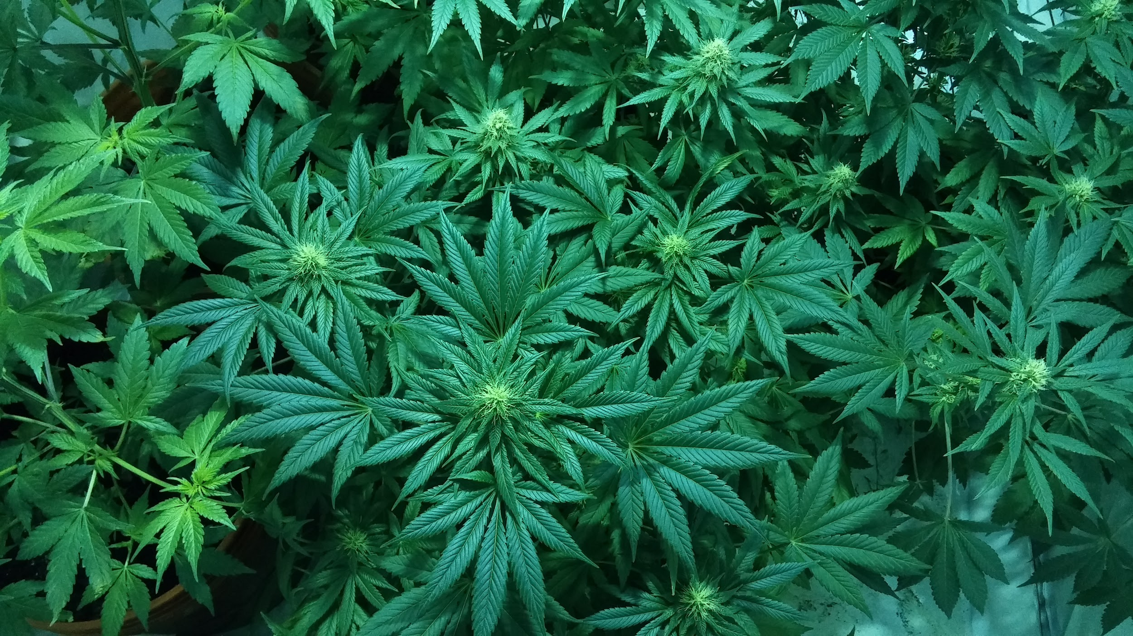
#Marijuanatheydontwanna

Slide 6
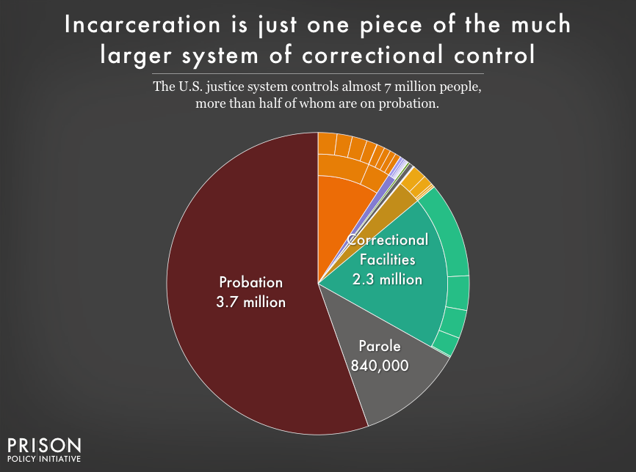
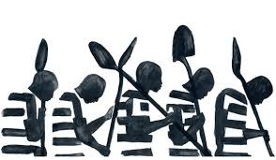
#AbuseIsAbuse

Slide 7
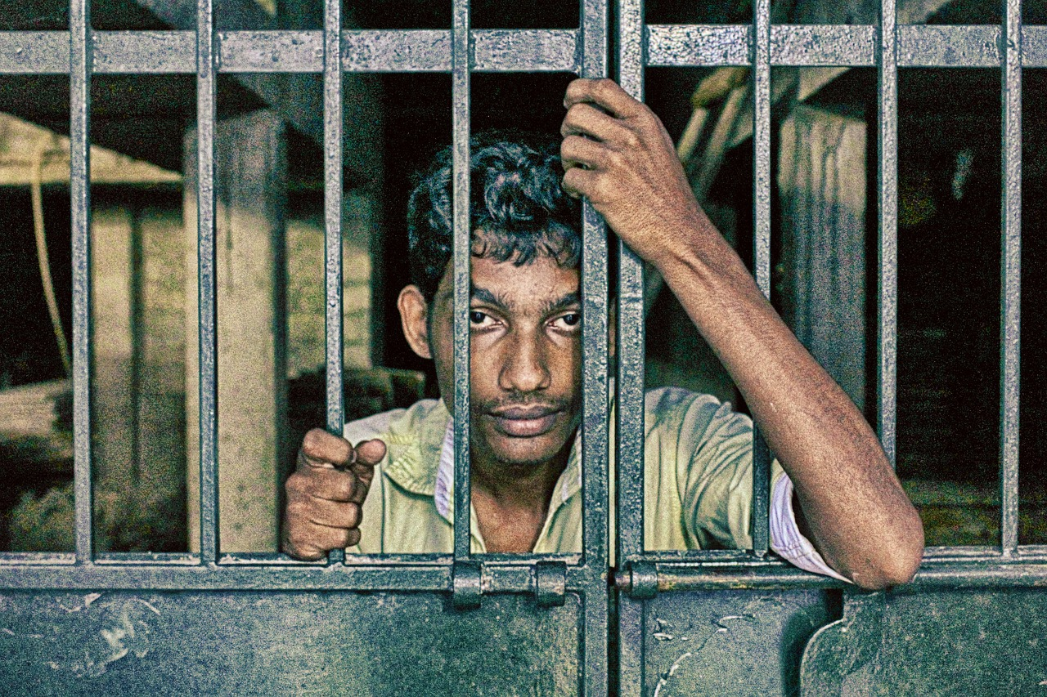
For every nine people executed in this country, one innocent person has been exonerated. #deathrowmustgo

